Slide 1
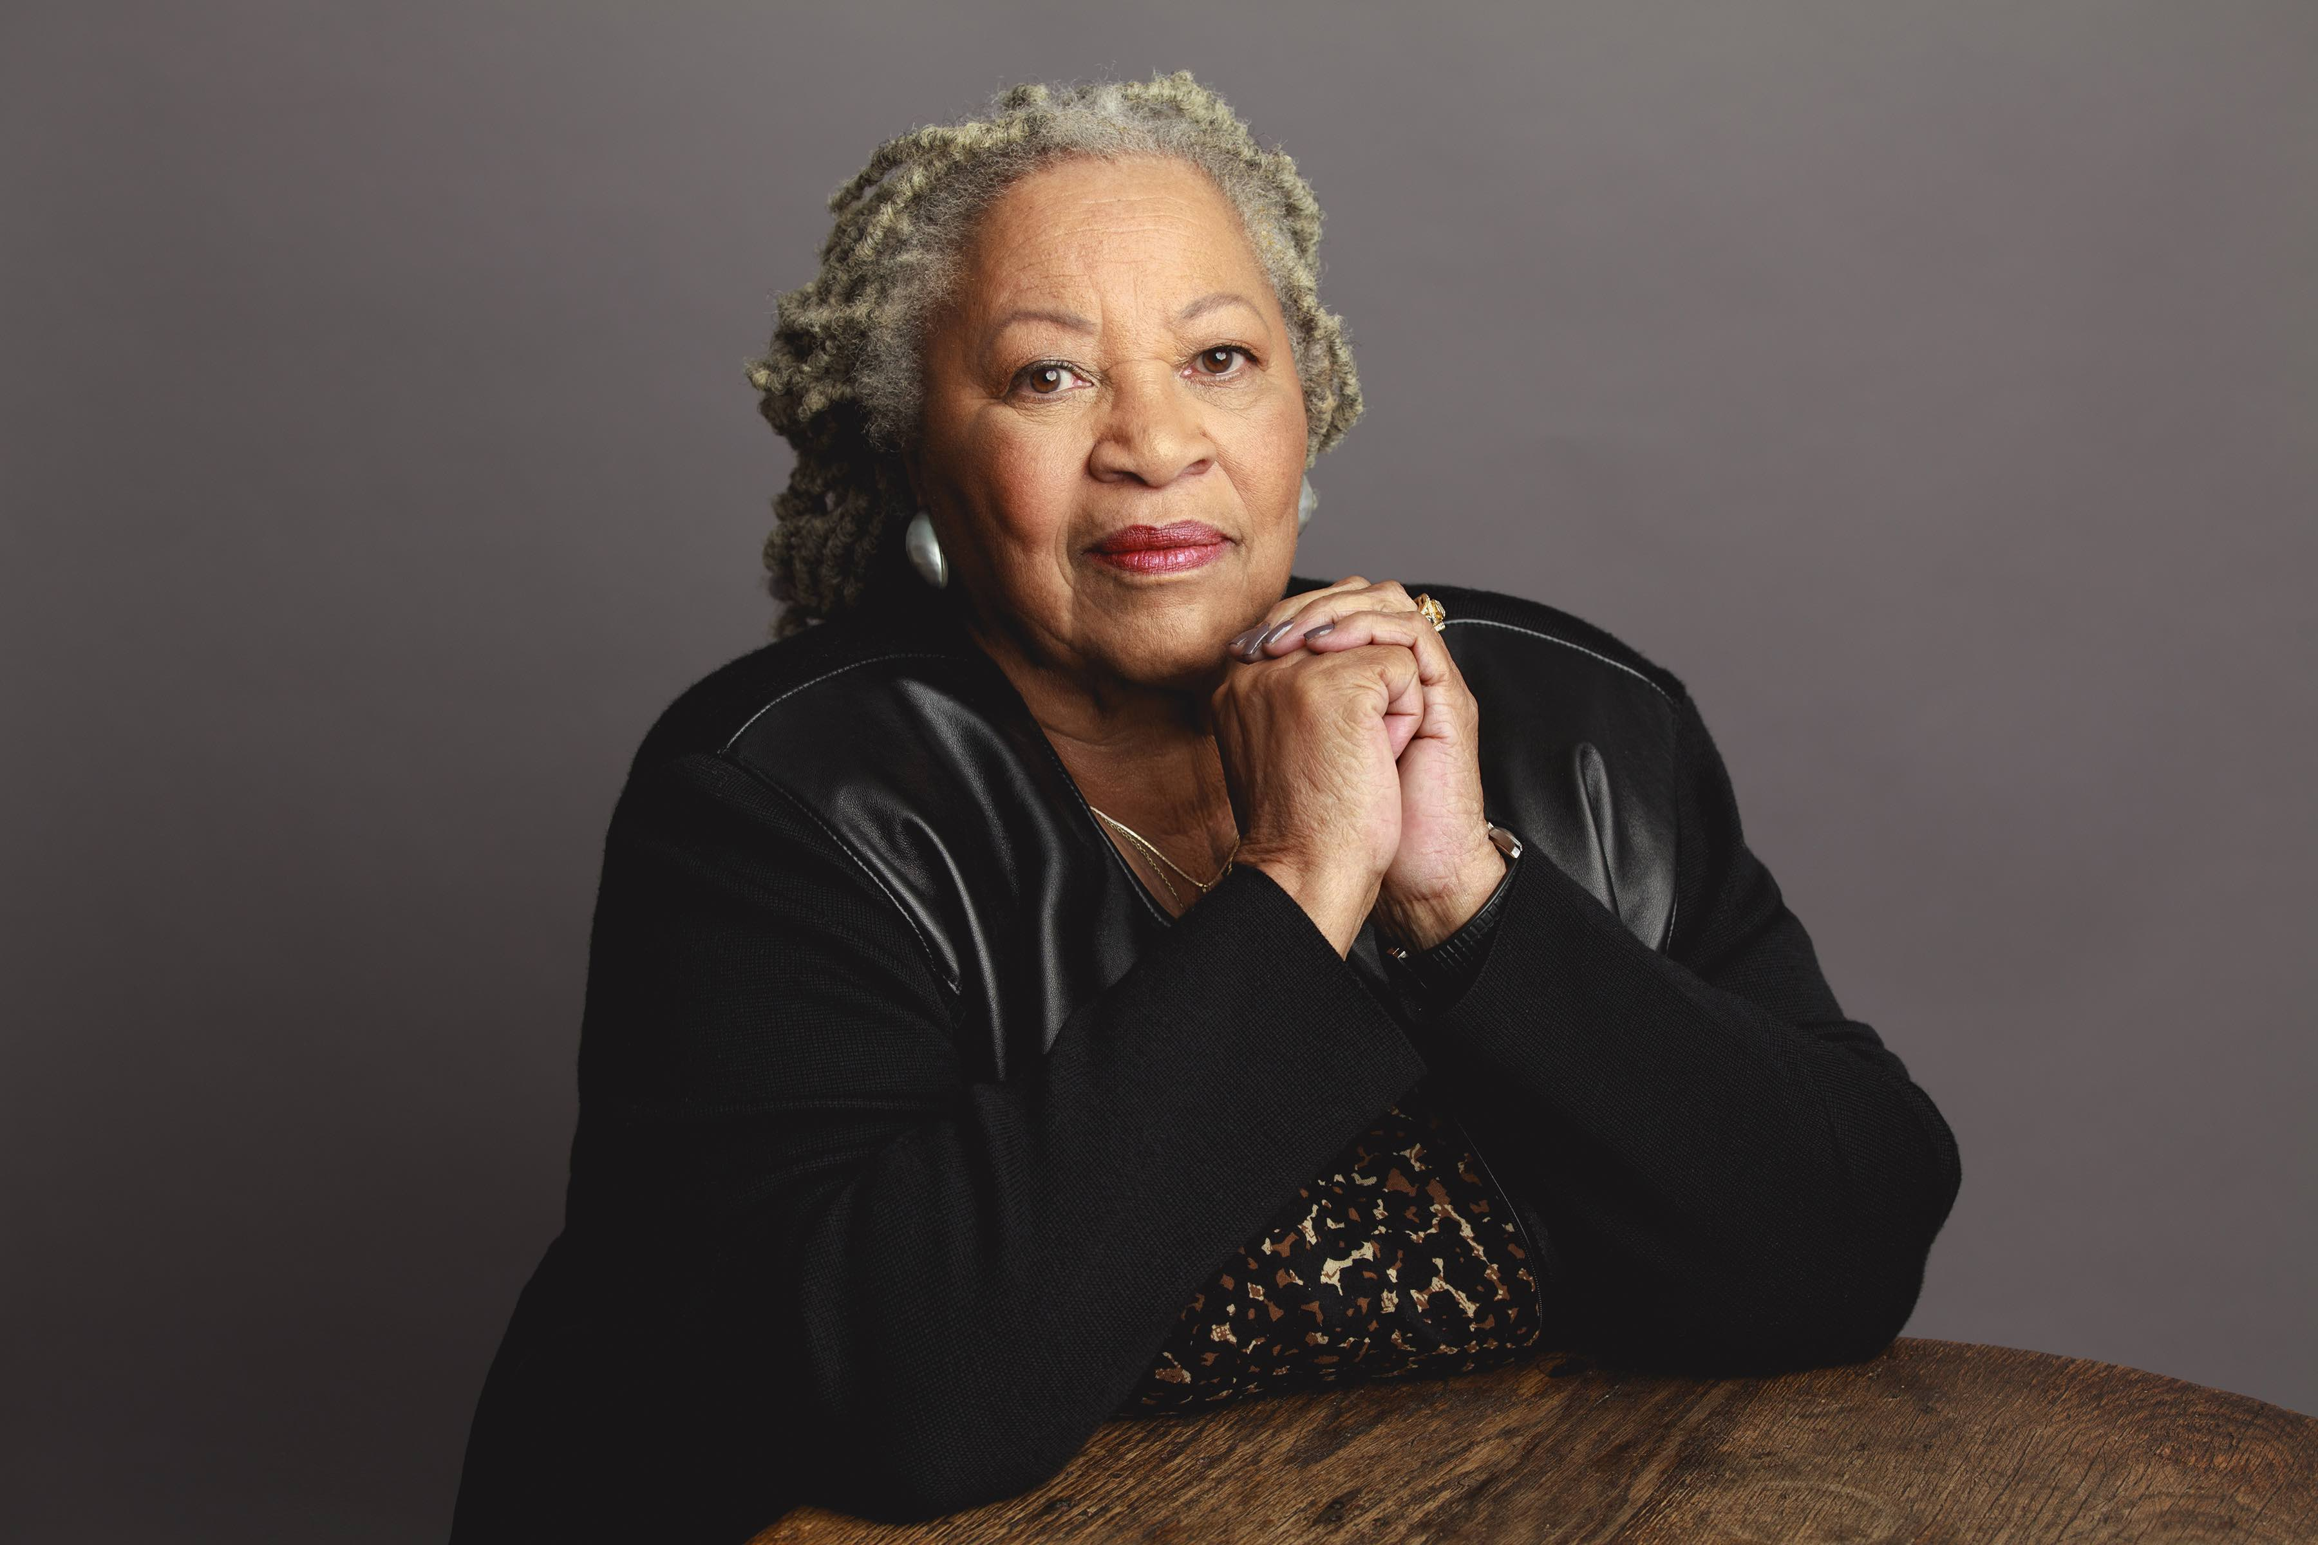
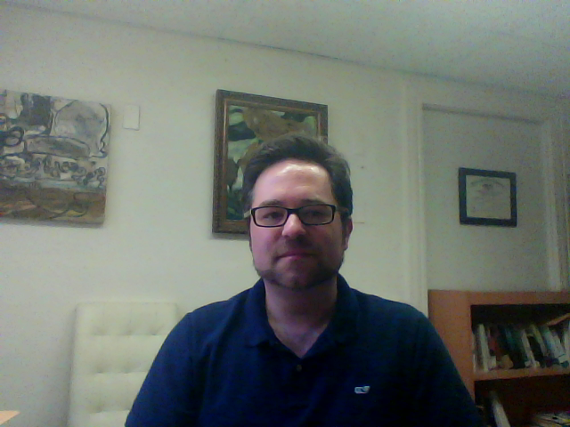
HUSB 143 Contemporary American Literature
Toni Morrison, “Recitatif”

